Slide 1
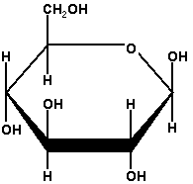
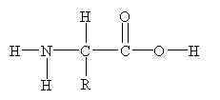
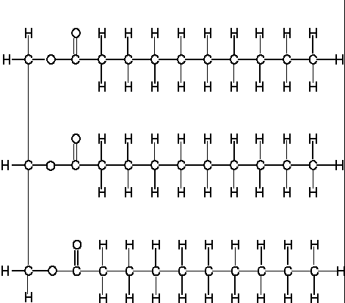
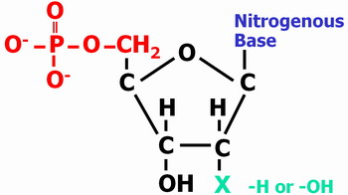
Biochemistry
Introduction of Macromolecules
Notes Courtesy of Keeley Lowery- Carroll High School

Slide 2
Biochemistry
Biochemistry is the study of chemical reactions in living systems. Biomolecules are organic compounds, meaning they are based on carbon chemistry. Remember that carbon is unique in that it can form 4 covalent bonds; thus it is able to form long, complex chains of atoms.

Slide 3
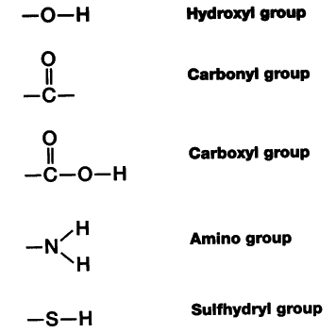
Functional groups attached to the carbon skeleton determine the characteristics of the compound. Know these examples!
Polar
Acidic
Basic

Slide 4
Organic Substances
Organic substances, macromolecules, or biomolecules make up all living things.
The four groups of substances are
carbohydrates
lipids
proteins
nucleic acids
polymers

Slide 5
Organic Substances
Polymers are formed from the linking together of many similar monomers.
Monomers are joined through a process known as dehydration synthesis, the removal of water.
monomer + monomer polymer + H₂O

Slide 6
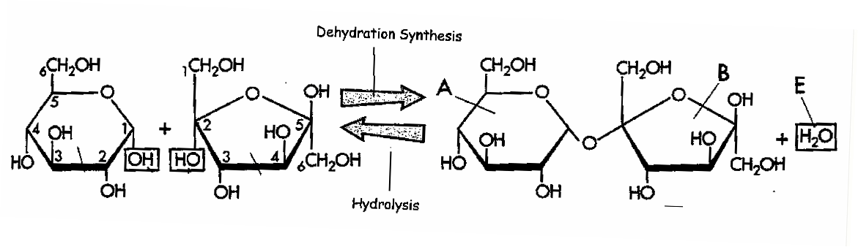
Dehydration synthesis
Hydrolysis

Slide 7

Organic Substances
Hydrolysis is the breaking of the bonds between monomers in a polymer by adding water.
This process is necessary in digestion so that molecules can be small enough to be absorbed and transported into the cell.
polymer + H₂O monomer + monomer

Slide 8
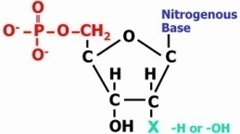
Organic Substances
Structure | Subunit | Types | Roles | Examples | Identification
Carbohydrate
Lipids
Protein
Nucleic Acid

Slide 9
Carbon ring
C₆H₁₂O ₆
Carbohydrates
Organic compounds that have the formula Cn(H₂O)n or 1:2:1
Monosaccharides
Disaccharides
Polysaccharides
http://www.wisc-online.com/objects/index_tj.asp?objid=AP13104

Slide 10
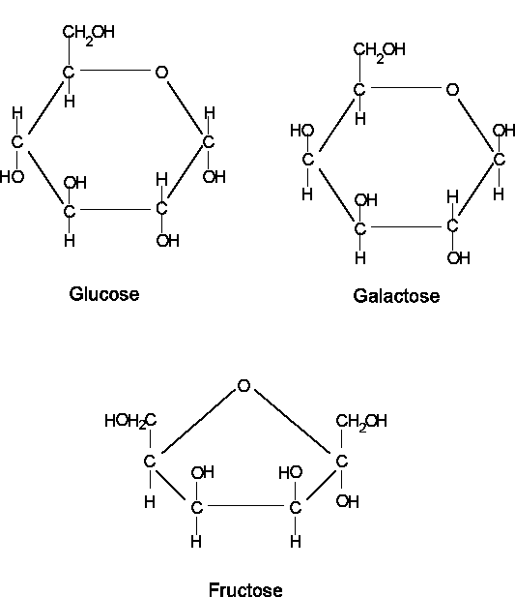
Carbon ring
C₆H₁₂O ₆
Fuel for
Respiration
Monosaccharides

Slide 11
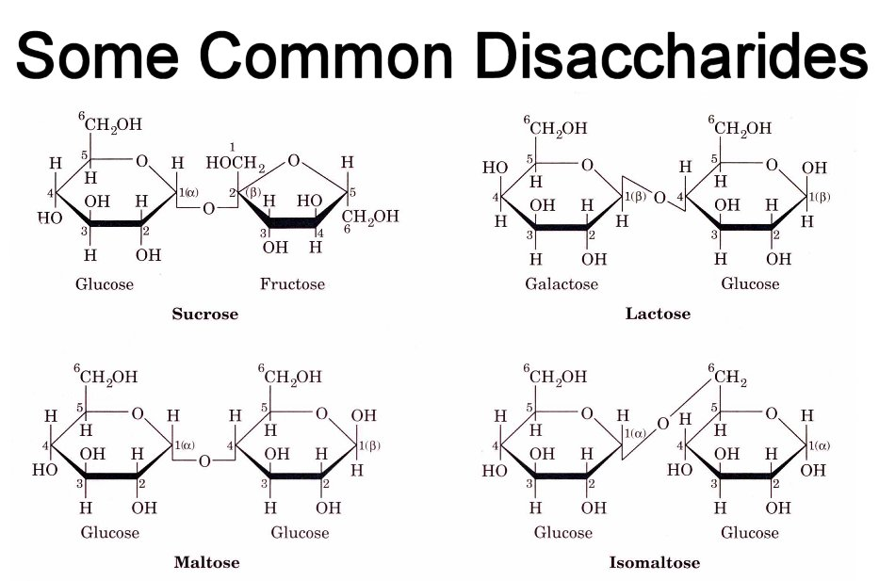
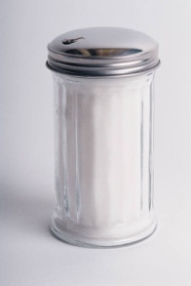

Slide 12
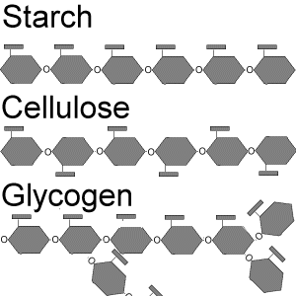
Carbon ring
C₆H₁₂O ₆
Polysaccharides

Slide 13
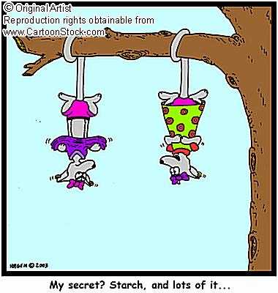
Carbon ring
C₆H₁₂O ₆
Polysaccharides
Starch
Starch
A storage molecule found in plants. Plants store sugars in the form of starch for later use.
Starch
Starch

Slide 14
Carbon ring
C₆H₁₂O ₆
Polysaccharides
Glycogen
Glycogen
A storage molecule found in animals. Animals store sugars in the form of glycogen in the liver for later use.
Glycogen
Glycogen

Slide 15
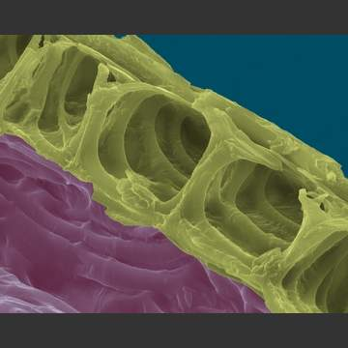
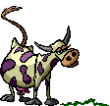
Carbon ring
C₆H₁₂O ₆
Polysaccharides
Cellulose
Cellulose
A major component in cell walls. The cellulose enables the plants to have rigid cell walls which allows them to have sturdy trunks and branches.
Only a few organisms have the enzymes necessary for digesting cellulose.

Slide 16
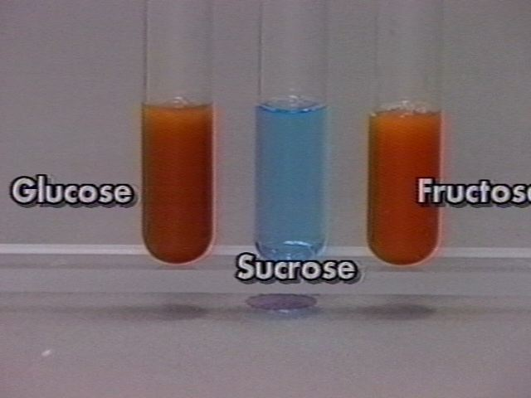
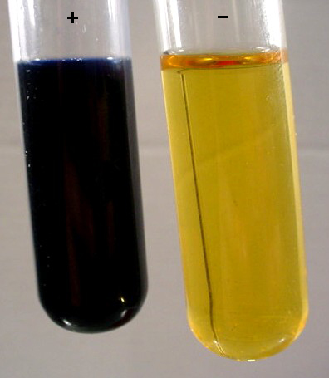
Carbon ring
C₆H₁₂O ₆
Chemical Tests
Benedict’s reagent is used to test for simple sugars (mono-
saccharides) like glucose and fructose. When heated,
Benedict’s reagent changes color from light blue to red/orange
if a simple sugar is present.
+ - +
Iodine solution is used to test for the presence of polysaccharides (starch). If starch is present, a color change from amber to purple/black occurs.
Starch No starch

Slide 17
Organic Substances
Structure | Subunit | Types | Roles | Examples | Identification
Carbohydrate | Monosaccharides
Lipids
Protein
Nucleic Acid
Glucose
Fructose
Cellulose
Glycogen
Starch
Benedict’s Reagent
Iodine
Monosaccharides
Polysaccharides
Quick Energy
Delayed energy
Cell components

Slide 18
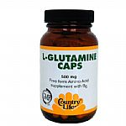
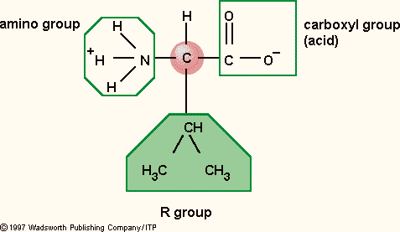
A central carbon atom
Is bonded to:
Amino group
Hydrogen atom
Carboxyl group
R group (varies)
Proteins
Proteins are macromolecules comprised of chains of amino acids.
http://www.wisc-online.com/objects/index_tj.asp?objid=AP13304

Slide 19
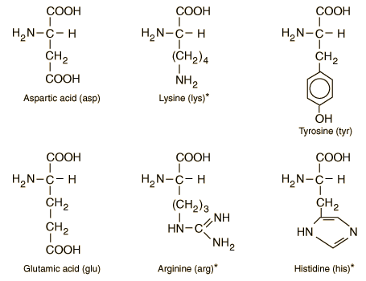
A central carbon atom
Is bonded to:
Amino group
Hydrogen atom
Carboxyl group
R group (varies)
Proteins
Are these amino acids polar, acidic, or basic?
Which ones are hydrophilic, which are hydrophobic?
How do you know?
Carboyxl Group
R Group
Amino Group

Slide 20
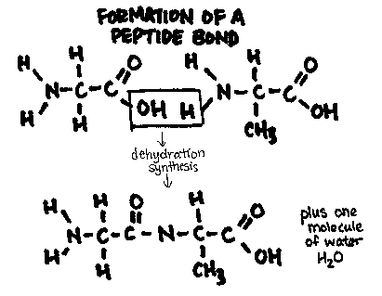
A central carbon atom
Is bonded to:
Amino group
Hydrogen atom
Carboxyl group
R group (varies)
Proteins

Slide 21
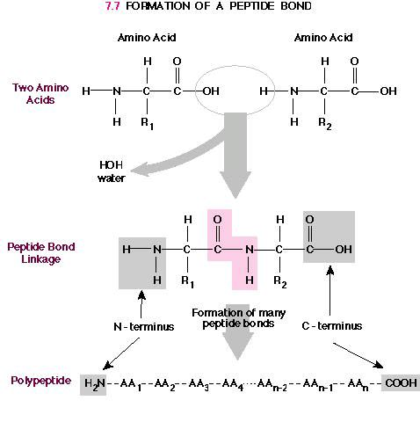
Proteins

Slide 22
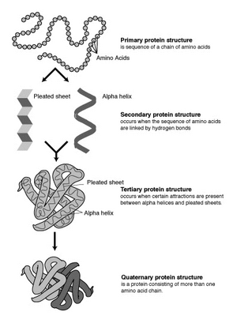
A central carbon atom
Is bonded to:
Amino group
Hydrogen atom
Carboxyl group
R group (varies)
Proteins

Slide 23
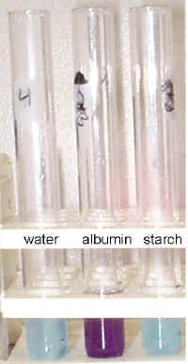
A central carbon atom
Is bonded to:
Amino group
Hydrogen atom
Carboxyl group
R group (varies)
Chemical Tests
Biuret reagent is used to test for the presence of protein.
When protein is present, biuret reagent changes from light
blue to purple.
- + -

Slide 24
Organic Substances
Structure | Subunit | Types | Roles | Examples | Identification
Carbohydrate
Lipids
Protein | Amino acids
Nucleic Acid
Meats
Hormones
Muscle
Hair
Nails
Enzymes
Blood Cells
Many types
Biuret’s Reagent
catalysts transport movement protection
immune growth

Slide 25
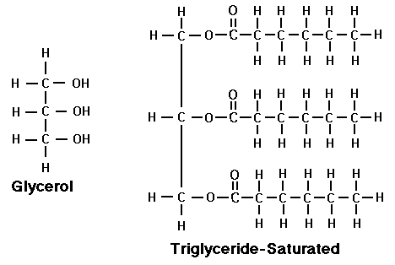
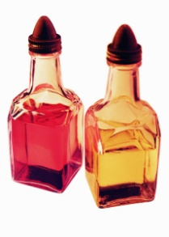
Glycerol
+
Fatty Acid tails
Lipids
Comprised of C, H, and O.
Lipids are insoluble in water.
Lipids include phospholipids, and fats (AKA triglycerides).
triglycerides
http://www.wisc-online.com/objects/index_tj.asp?objid=AP13204

Slide 26
Glycerol
+
Fatty Acid tails
Lipids
Glycerol
Fatty Acid tails

Slide 27
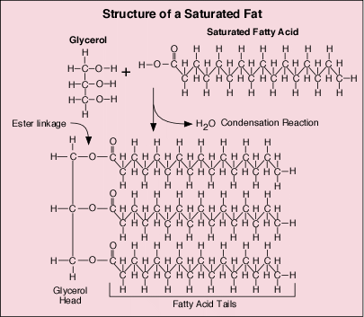
How are lipids assembled?

Slide 28
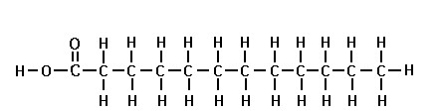
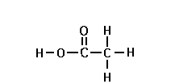
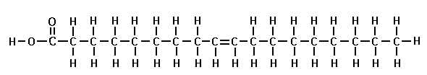
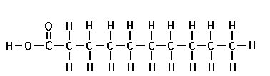
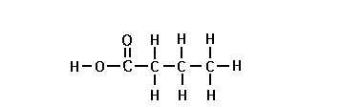
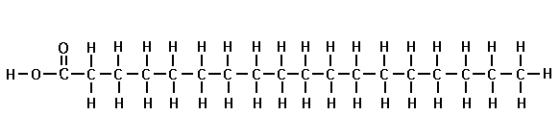
What do these all have in common?
Which one is different?
A
C
B
E
D
F

Slide 29
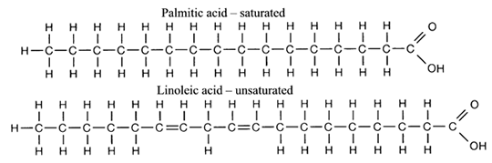
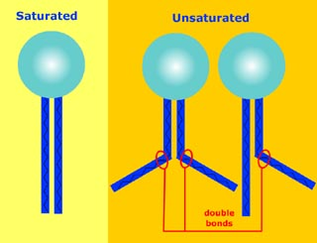
Saturated
Animal fats
Solid at room temp
Lacks double bond in Carbon chain
Unsaturated
Plant fats
Remain liquid at room temp.
Has a double bond in Carbon chain
Lipids

Slide 30
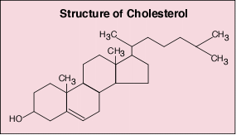

Slide 31
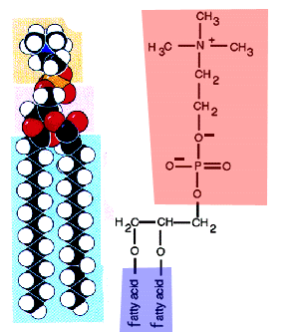
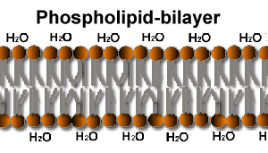
LIPIDS
Cell Membrane
“PHOSPHO”LIPID

Slide 32
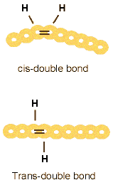
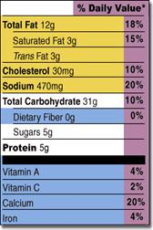
LIPIDS
What are trans fats ?
UNSATURATED
TRANS FAT

Slide 33
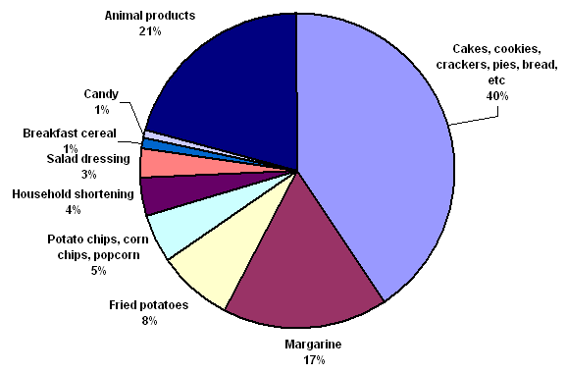
LIPIDS
Major Food Sources of Trans Fat for American Adults

Slide 34
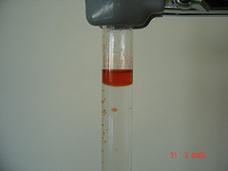
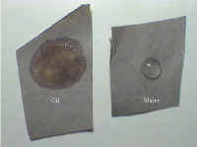
Tests for Lipids
Sudan III is a chemical test for the presence of lipids. If lipids are present,
this indicator will turn orange-pink.
+
Brown paper may also be used to test for the presence of lipids. Lipids
soak into the paper, causing it to have a translucent appearance.
+ -

Slide 35
Organic Substances
Structure | Subunit | Types | Roles | Examples | Identification
Carbohydrate
Lipids
Protein
Nucleic Acid
Glycerol +
Fatty acids
Cholesterol
Phospholipids
Fats:
Saturated
Unsaturated
Stored energy
Insulation
Cell Components
Fats
Oils
Waxes
Sudan III
Brown paper

Slide 36
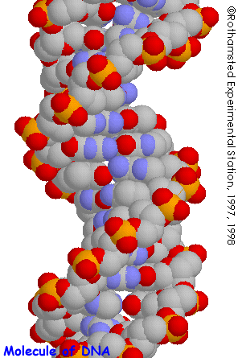
NUCLEIC ACIDS
RNA
DNA

Slide 37
NUCLEIC ACIDS
Nucleic acids are the only macromolecules with the unique ability to REPRODUCE themselves and carry the code that directs all of the cell’s activities.

Slide 38
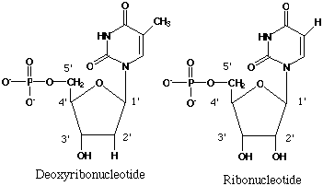
NUCLEIC ACIDS
The subunits (monomers, building blocks) of nucleic acids are called
NUCLEOTIDES.
nitrogen base
phosphate
sugar
(Pentose- 5 Carbon)

Slide 39
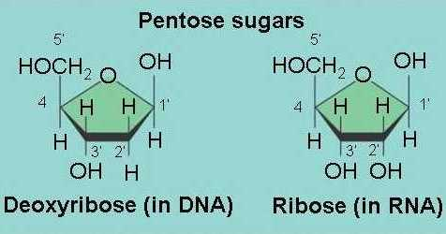
NUCLEIC ACIDS
The pentose (5 carbon) sugar in a nucleotide is either ribose (RNA) or deoxyribose (DNA).

Slide 40
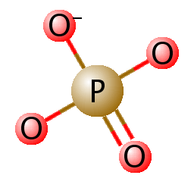
NUCLEIC ACIDS
PHOSPHATE GROUP

Slide 41
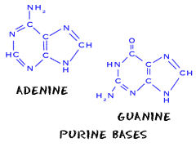
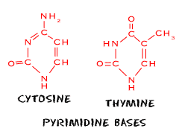
NUCLEIC ACIDS
The NITROGEN BASES fit into 2 families:
6 membered rings of carbon and nitrogen atoms.
CYTOSINE (C)
THYMINE (T) – DNA
URACIL (U) - RNA
5 membered ring attached to a pyrimadine ring.
ADENINE (A) & GUANINE (G)

Slide 42
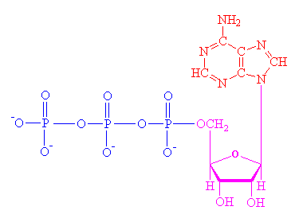
NUCLEIC ACIDS
ATP
ADENOSINE TRIPHOSPHATE
An individual nucleotide that functions in energy transfer (acts like a battery) in the cell.
adenine
triphosphate
ribose

Slide 43
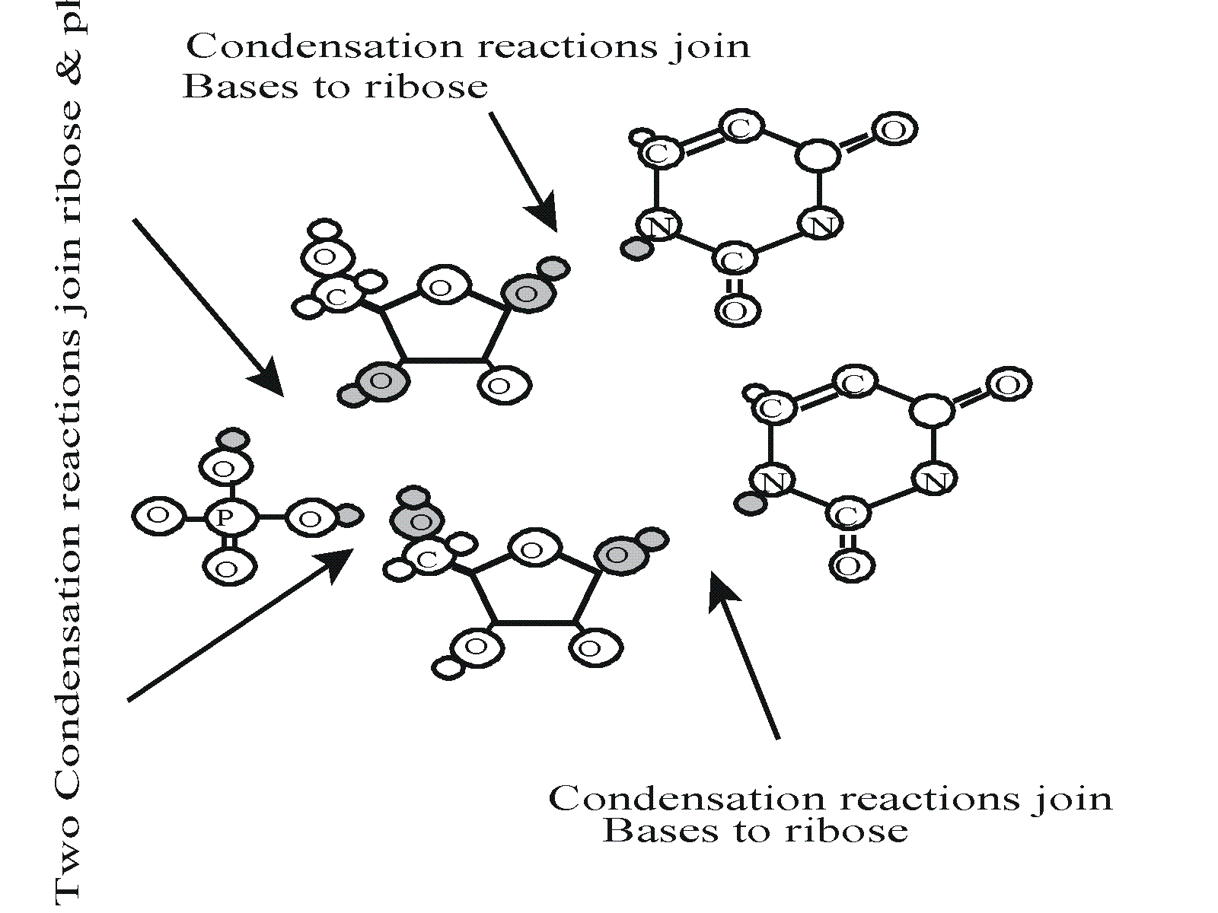
NUCLEIC ACIDS
Condensation reactions (dehydration synthesis) join the nitrogen bases to the ribose. The same type of reaction happens twice to join the phosphate group to the adjoining riboses.
Polynucleotides

Slide 44

NUCLEIC ACIDS
Polynucleotides:
DNA – Deoxyribonucleic Acid is made up of 2 polynucleotide chains twisted around a central axis. The nitrogen bases that make up DNA are A, G, C, and T.
RNA – Ribonucleic Acid is a single stranded chain made up of the nitrogen bases A, G, C, and U.

Slide 45
Organic Substances
Structure | Subunit | Types | Roles | Examples | Identification
Carbohydrate
Lipids
Protein
Nucleic Acid
Nucleotides
DNA
RNA
ATP
Direct cell processes
Protein Synthesis
Cellular energy
DNA
RNA
ATP
None ☺

Slide 46

Enzyme Activity
Measuring the Effect of Enzyme Concentration

Slide 47

Drawing Courtesy of Keeley Lowery- Carroll High School
  Enzymes and Catalysts speed up reactions by lowering activation energy without being used up! Substrates are placed in close proximity and the correct orientation to interact.
  Activation Energy- energy needed to start a reaction.
  Substrate- chemical that bond to the active site.
  Enzyme-Substrate Complex- The substrate and enzyme are bonded together.
  Inhibitors
    Competitive- Competes for the active site with the substrate.
    Non-competitive- change the shape of the active site so the substrate cannot attach to the site.

Slide 48
Enzyme Activity
Today’s reaction:
catalase
Hydrogen peroxide water + oxygen
What is the enzyme? substrate? product(s)?

